Slide 1

USAMV BUCUREȘTI · STUDENT SYMPOSIUM 2026
Development of a Digital Twin for the USAMV Bucharest Campus
Using Terrestrial Scanning and Geospatial Technologies
A Comparative Analysis between Romania and Nordic Countries
AUTHORS
SCIENTIFIC COORDINATOR
■ Roxana Maria HAICAN
■ Alexandra-Ionela NISTOR (corresponding)
Lect. PhD. Eng.
■ Nicoleta PAVEL
■ Ana Maria SAVU
Alexandru CALIN
■ Iulian-Sebastian HAGIU
■ Vlad-Andrei HAICAN
Faculty of Land Reclamation and Environmental Engineering
59 Mărăști Blvd · District 1 · 011464 București · România

Slide 2
OUTLINE
Agenda
01
Context & objectives
02
State of the art
03
Methodology
Digital twin definition, research goal
Nordic countries: Finland, Denmark, Sweden, Norway
Multi-sensor workflow: UAV + SLAM LiDAR
04
Aerial acquisition
05
Terrestrial acquisition
06
Visualization modes
DJI Mini 2 — 419 photos · 32 min · 4.99 km
FJD Trion S2 — 17,272 poses · 6.5 M points
RGB vs intensity · FJD Trion Studio
07
Data fusion & georeference
08
Online interactive viewers
09
Conclusions & future work
ICP in CloudCompare · RMS < 3 cm · LOD 200–300
drone.ugaerial.ro — orthophoto + Potree 3D
BIM, 3DGS, sustainable campus planning
Digital Twin USAMV București · Comparative Analysis: Romania vs Nordic Countries
2 / 19

Slide 3
CONTEXT · OBJECTIVES
What is a Digital Twin?
A Digital Twin is a three-dimensional digital replica of a real-world environment,
increasingly used in urban planning, infrastructure management, and academic research.
While Nordic countries (Denmark, Sweden, Finland, Norway) have systematically integrated such
frameworks into planning workflows, Romania exhibits limited adoption, primarily due to
financial constraints and restricted access to advanced geospatial infrastructure.
RESEARCH GOAL
Develop a detailed digital twin of the USAMV Bucharest campus using
cost-effective geospatial technologies, while comparing methodology with Nordic practices.
▸ UAV Photogrammetry
▸ SLAM LiDAR
▸ Multi-sensor Fusion
Digital Twin USAMV București · Comparative Analysis: Romania vs Nordic Countries
3 / 19

Slide 4
STATE OF THE ART
Nordic Countries — Geospatial Reference Frameworks
FINLAND
DENMARK
SWEDEN
NORWAY
Helsinki 3D+
GeoDanmark
Lantmäteriet
Kartverket
City-scale digital twin · UAV photogrammetry + mobile mapping + SLAM handheld
Distributed acquisition · GNSS RTK · DJI UAV · high-res RGB sensors
Mobile LiDAR + UAV (Phantom, Matrice) · GNSS/IMU continuous capture
National mapping authority — UAV + terrestrial LiDAR · open data
TOOLS
TOOLS
TOOLS
TOOLS
Agisoft Metashape · CloudCompare · GIS
Pix4Dmapper · Metashape · ArcGIS Pro
SfM in Metashape · CloudCompare · ArcGIS
Standardized 2–5 cm urban accuracy
Common denominator: fit-for-purpose accuracy ≈ 2–5 cm · cost-efficient acquisition · scalable workflows
Digital Twin USAMV București · Comparative Analysis: Romania vs Nordic Countries
4 / 19

Slide 5
MOTIVATION
Romania vs Nordic — Gap and Opportunity
ROMANIA TODAY
NORDIC MODEL
• Limited adoption of digital twin frameworks
• High-cost equipment barrier for institutions
• Restricted access to advanced infrastructure
• Few national-level open geospatial standards
• Digital twin practice still in emerging stage
• Systematic integration into urban planning
• Consumer- and prosumer-grade equipment
• Open data culture, national initiatives
• Fit-for-purpose accuracy (2–5 cm)
• Smart city, climate-resilient applications
OUR PROPOSAL
Adapt the Nordic workflow to Romanian reality through accessible technology:
DJI Mini 2 + FJD Trion S2 → ~60–80% lower equipment cost · ~50–65% less acquisition time
Digital Twin USAMV București · Comparative Analysis: Romania vs Nordic Countries
5 / 19

Slide 6
WORKFLOW
Integrated Multi-Sensor Methodology
01
02
03
04
ACQUISITION
PROCESSING
ALIGNMENT
DIGITAL TWIN
▶
▶
▶
Aerial UAV + Terrestrial SLAM
SfM / MVS in Agisoft Metashape SLAM optim. in FJD Trion Studio
Coarse + ICP fine registration in CloudCompare
Unified 3D model LOD 200–300 · RMS < 3 cm
UAV PHOTOGRAMMETRY
SLAM LiDAR (TERRESTRIAL)
• Rooftops and upper façades
• Extended spatial coverage
• RGB texture for visualization
• Limitation: no ground-level detail
• Indoor corridors, rooms, staircases
• High-density geometry (cm-level)
• Loop closure reduces drift
• Limitation: no roof access
Digital Twin USAMV București · Comparative Analysis: Romania vs Nordic Countries
6 / 19

Slide 7
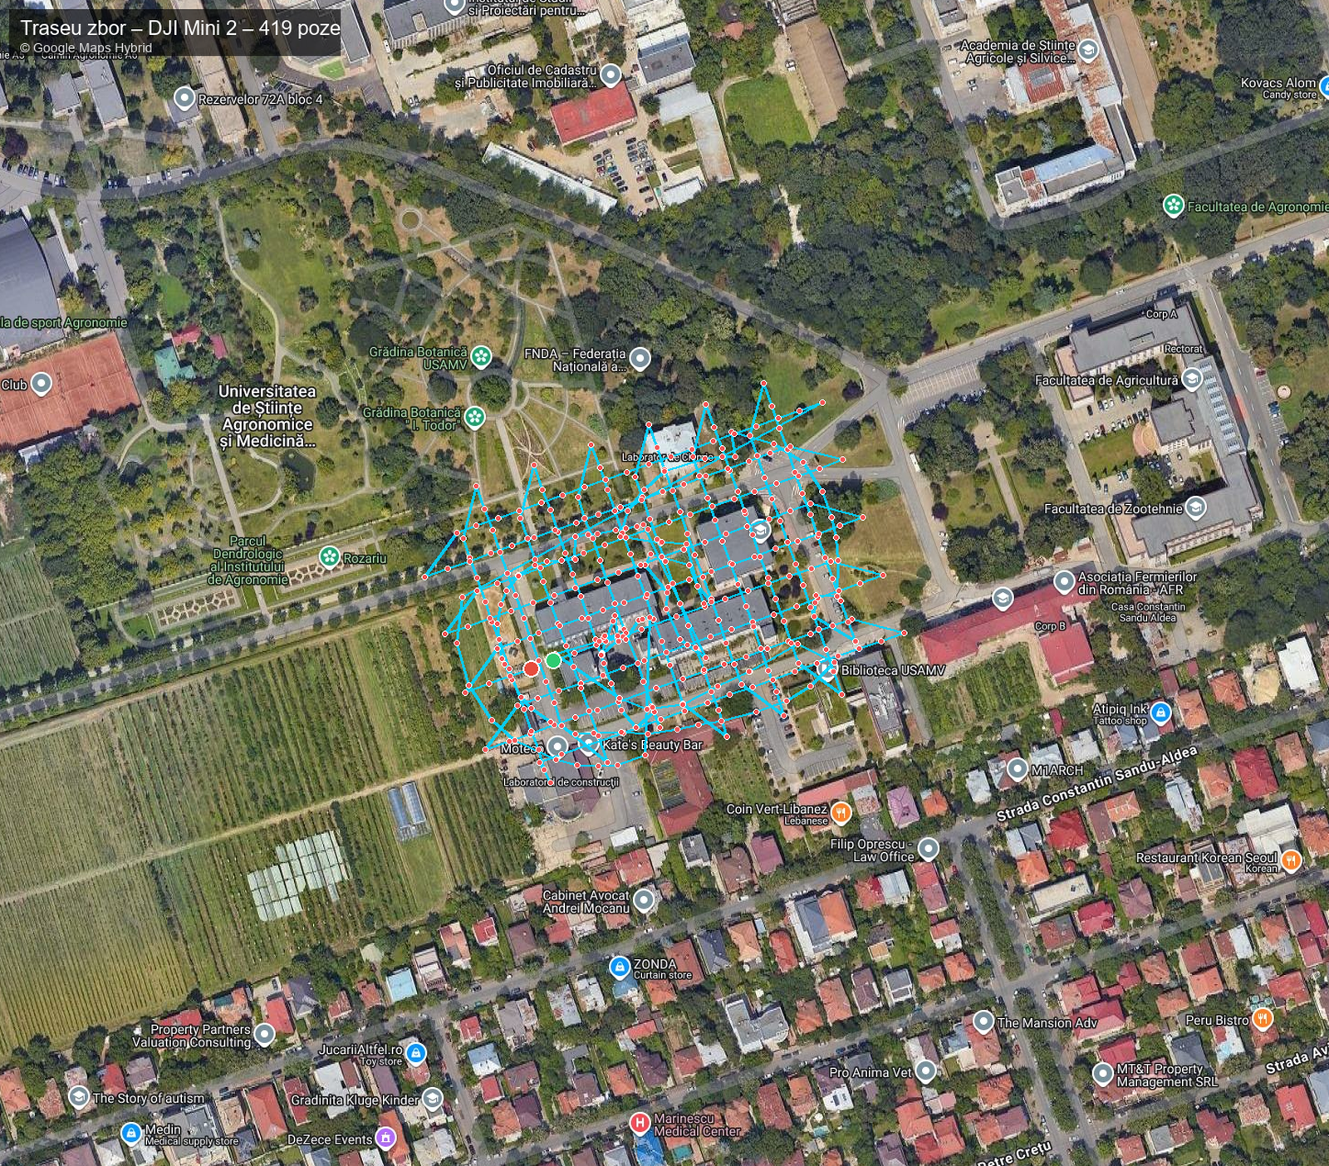
UAV PHOTOGRAMMETRY
Aerial Acquisition — DJI Mini 2
DJI MINI 2
USAMV CAMPUS — MISSION RESULTS
Lightweight UAV · GPS / GLONASS · 3-axis gimbal
Photos captured
Flight duration
Path length
419
32.4 min
4.99 km
Weight
< 249 g
all geo-tagged
single battery
grid + orbital
Camera
12 MP · 4000 × 3000 px
Area covered
Altitude AGL
Capture cadence
Focal length
4.49 mm (≈ 24 mm equiv.)
~ 0.41 ha
~ 100–135 m
12.9 / min
Aperture / ISO
f/2.8 · ISO 100
222 × 185 m
MSL 172–212 m
auto-trigger
Stabilization
3-axis mechanical gimbal
Positioning
GNSS (GPS + GLONASS), no RTK/PPK
Geo-referencing
via Ground Control Points (GCPs)
Flight strategy
Nadir 30–50 m + oblique 45°
Image overlap
70–80% forward & lateral
Fig. 1 — Aerial flight track over USAMV campus
Digital Twin USAMV București · Comparative Analysis: Romania vs Nordic Countries
7 / 19

Slide 8
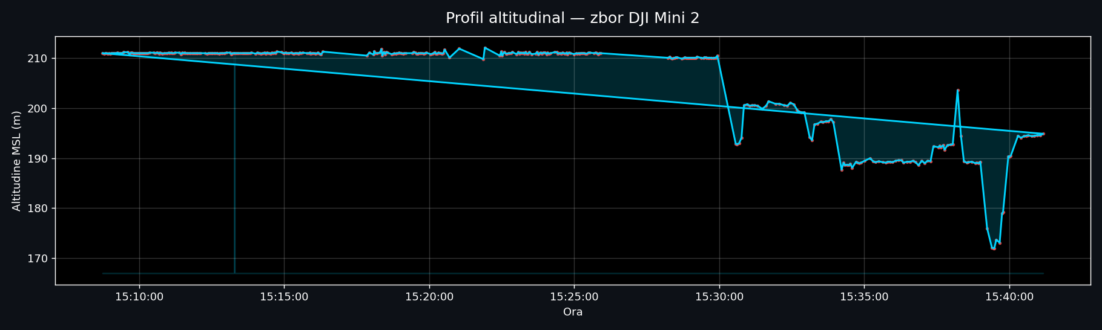
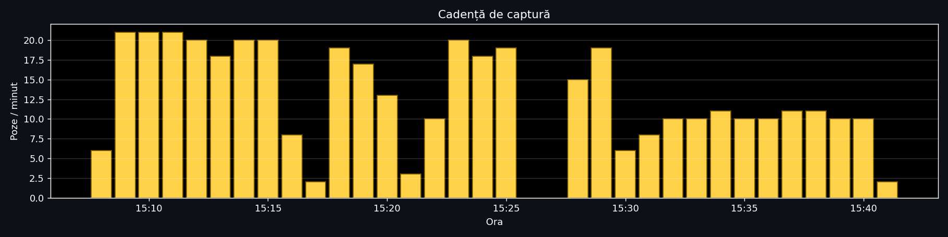
AERIAL ACQUISITION RESULTS
UAV Mission — Altitude Profile & Capture Cadence
Fig. 2 — Altitude (top) and capture rate (bottom). Stable plateau ≈ 206 m MSL ≈ 135 m AGL.
Digital Twin USAMV București · Comparative Analysis: Romania vs Nordic Countries
8 / 19

Slide 9
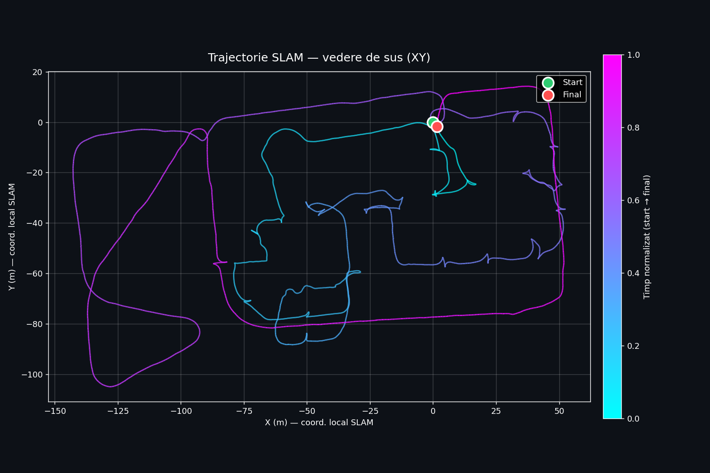
SLAM LiDAR
Terrestrial Acquisition — FJD Trion S2
FJD TRION S2
USAMV CAMPUS — SCAN RESULTS
Handheld SLAM LiDAR scanner · FJDynamics
SLAM poses
Scan duration
Trajectory
17,272
31.5 min
1.66 km
Weight
2 kg (with battery)
@ 9.1 Hz
1 battery
walking
LiDAR sensor
multi-line laser
Avg speed
Panoramic frames
LiDAR points
Field of view
360° × 270°
3.15 km/h
7,586
6.5 M
Range
up to 120 m (80% reflectivity)
0.88 m/s
3,793 × 2
14 PCD
Capture rate
640.000 pts / s
Relative accuracy
up to 1.2 cm
Cameras
2 × 12 MP panoramic
Positioning
SLAM + IMU + VIO + RTK / PPK
Operating mode
handheld, 0.5–1.0 m/s walk
Fig. 3 — SLAM trajectory (top view) · 17,272 poses · color = time
Digital Twin USAMV București · Comparative Analysis: Romania vs Nordic Countries
9 / 19

Slide 10
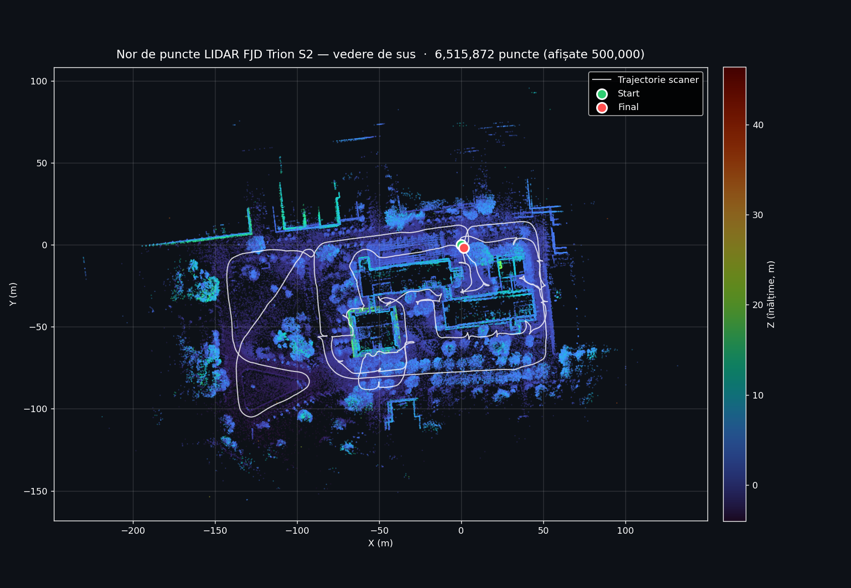
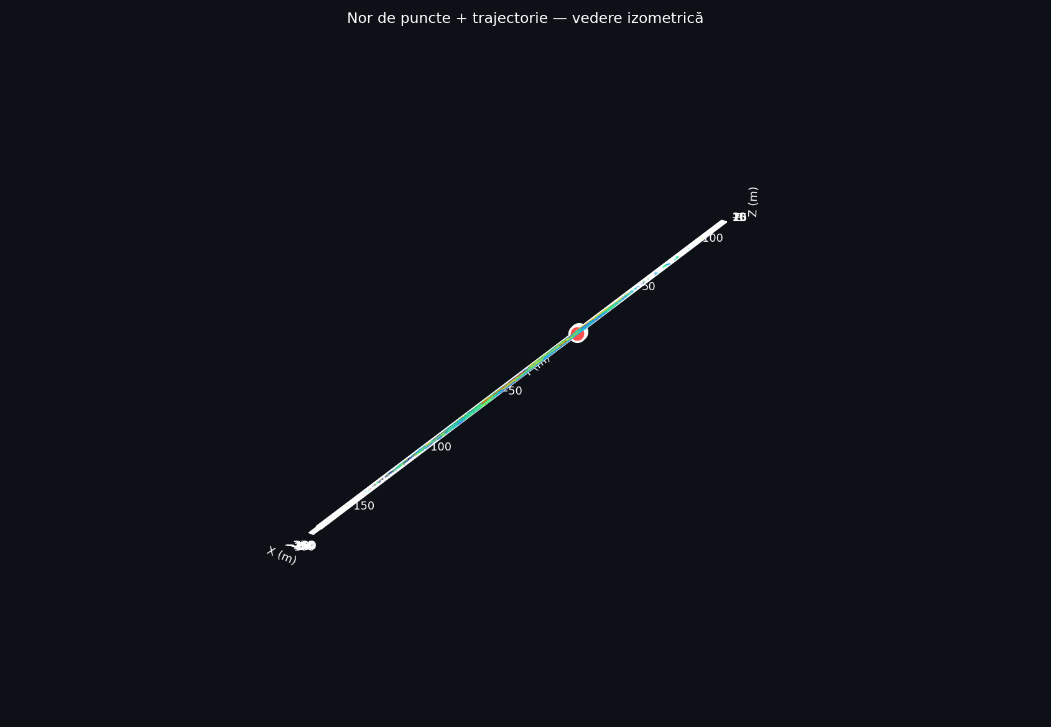
TERRESTRIAL ACQUISITION RESULTS
LiDAR Point Cloud — 6.5 Million Points
BOUNDING BOX
X (width)
195.3 m
Y (length)
119.2 m
Z (height)
3.6 m
Surface ≈
2.33 ha
Drift
loop closure applied
Fig. 4 — Top view (color = height Z) overlaid with white scanner trajectory
Digital Twin USAMV București · Comparative Analysis: Romania vs Nordic Countries
10 / 19

Slide 11
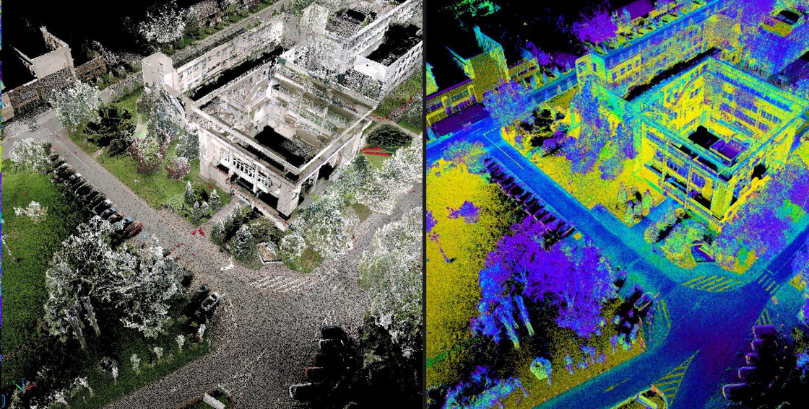
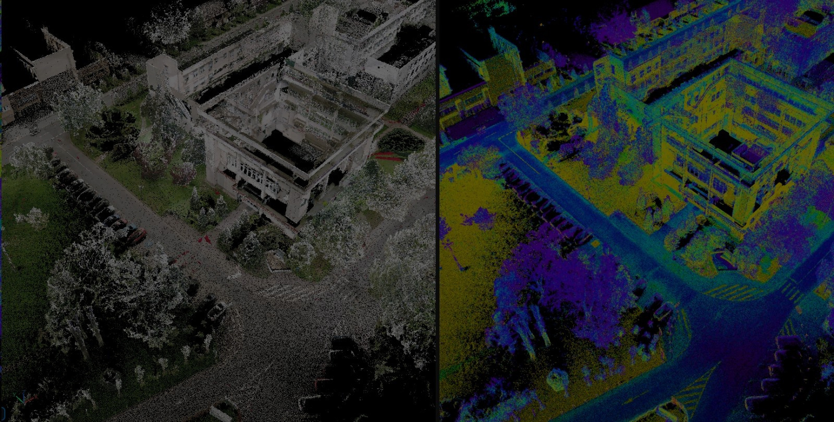
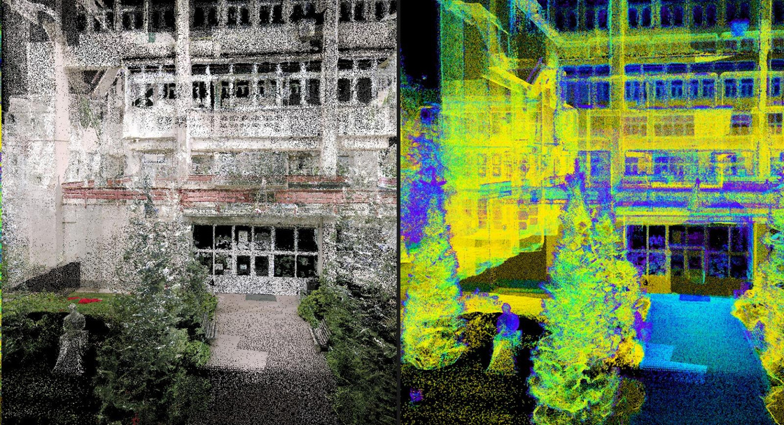
VISUALIZATION MODES
Point Cloud Visualization — RGB vs Intensity
Two visualization modes computed from the unified point cloud — RGB (left) for visual realism, intensity (right) for material analysis.
Top-view aerial
Façade aerial
Façade close-up
RGB ← → intensity
RGB ← → intensity
RGB ← → intensity
RGB visualization preserves true color from camera images — useful for visual interpretation and presentations.
Intensity visualization reflects LiDAR return strength — highlights material reflectivity and structural details invisible in RGB.
Digital Twin USAMV București · Comparative Analysis: Romania vs Nordic Countries
11 / 19

Slide 12
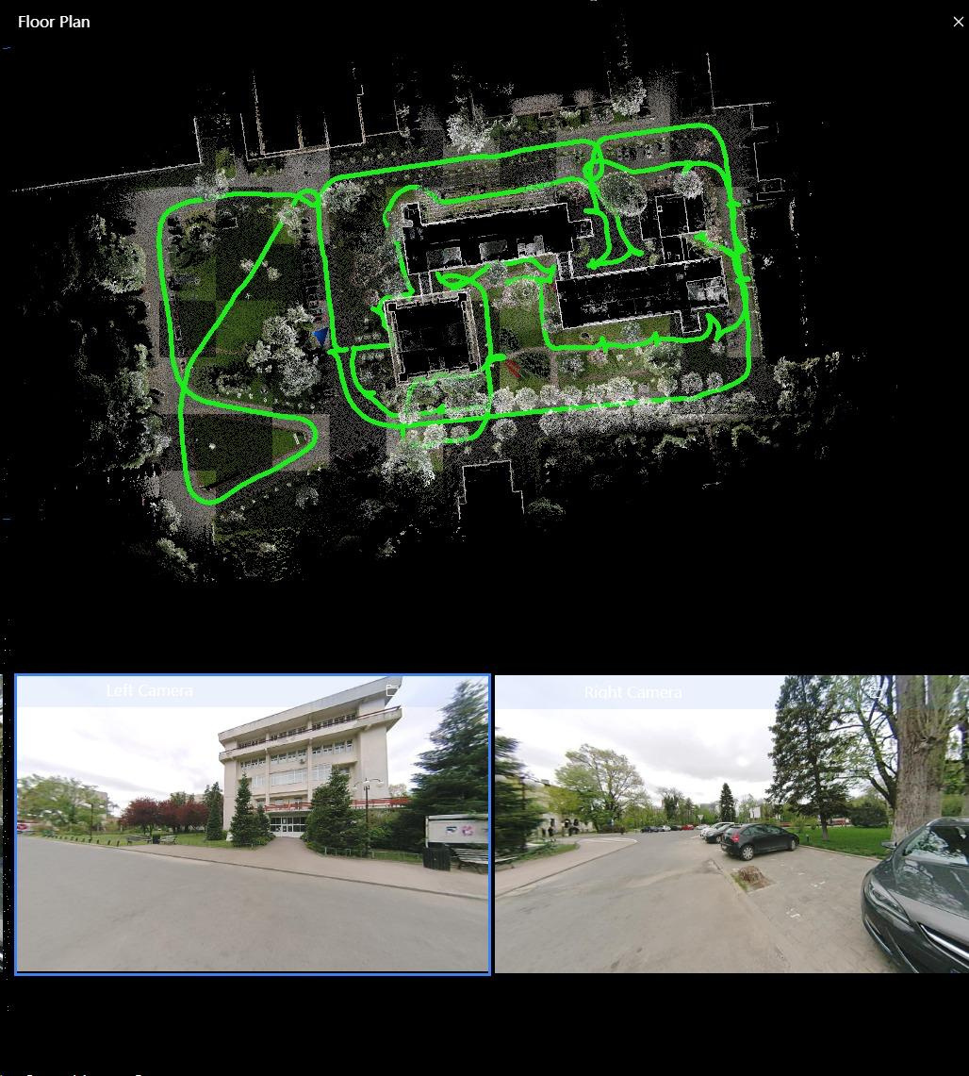
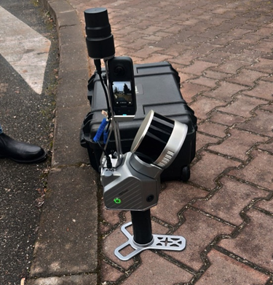
ACQUISITION SOFTWARE
FJD Trion Studio — Real-time Acquisition Interface
FJD Trion S2 deployed in the field
INTERFACE FEATURES
▸ Real-time floor plan view
▸ Live trajectory tracking (green path)
▸ Dual camera preview (L + R)
▸ On-site quality validation
▸ Loop closure indication
Fig. 5 — FJD Trion Studio: top — floor plan with live trajectory · bottom — left/right camera feeds
Digital Twin USAMV București · Comparative Analysis: Romania vs Nordic Countries
12 / 19

Slide 13
INTEGRATION & GEOREFERENCING
Data Fusion — ICP Alignment in CloudCompare
SLAM LiDAR
FUSION
UAV / SfM
• FJD Trion S2
• 6.5 M points
• Loop closure applied
• Local SLAM coordinates
ICP Registration
• DJI Mini 2 — 419 photos
• SfM + MVS in Agisoft Metashape
• Dense photogrammetric cloud
• Geo-ref via 5+ GCPs (RTK)
▶
(Iterative Closest Point)
◀
• Coarse alignment (manual)
• Fine ICP registration
• Convergence on shared surfaces
RESULT — UNIFIED 3D MODEL
RMS error
LOD
CRS
Estimated accuracy
< 3 cm
200 – 300
Stereo 70
2 – 5 cm
ICP convergence
BIM-compatible
EPSG:3844
centimetric
Suitable for: campus management · infrastructure monitoring · spatial analysis · BIM integration
Digital Twin USAMV București · Comparative Analysis: Romania vs Nordic Countries
13 / 19

Slide 14

LIVE VIEWER · 2D MAP
Interactive Orthophoto — UGA Aerial Hub
Geo-referenced orthophoto of USAMV / FIFIM area, served on our point-cloud hub.
URL (click in slideshow mode)
https://drone.ugaerial.ro/Orto_-_Facultate_Fifim_-_Test.tif/map
FEATURES
■ 2D map view with satellite + OpenStreetMap basemaps
■ Pan, zoom, area / distance measurements
■ Stereo 70 (EPSG:3844) georeference
■ Layer opacity, full-screen, share link
■ Mobile-friendly responsive UI
Scan to open on phone
Hosted on drone.ugaerial.ro · UGA Aerial Point Cloud Hub
Digital Twin USAMV București · Comparative Analysis: Romania vs Nordic Countries
14 / 19

Slide 15

LIVE VIEWER · 3D POINT CLOUD
Interactive Point Cloud — Potree 3D Viewer
Full LiDAR point cloud of FIFIM Faculty in any web browser. Includes measurement and section tools.
URL (click in slideshow mode)
https://drone.ugaerial.ro/LAZ_LIDAR_DRONA_FIFIM.las
FEATURES
■ Rotate / zoom / pan in 3D (mouse + scroll)
■ Measurements: distance, 3D area, volume
■ Vertical & horizontal sections, adjustable thickness
■ PNG + PGW export (georeferenced Stereo 70)
■ Solid Surface mode (HQ + EDL) for compact look
Scan to open on phone
Hosted on drone.ugaerial.ro · UGA Aerial Point Cloud Hub · Potree-based
Digital Twin USAMV București · Comparative Analysis: Romania vs Nordic Countries
15 / 19

Slide 16
ECONOMIC IMPACT
Cost & Time Efficiency vs. Conventional Surveying
EQUIPMENT COST REDUCTION
ACQUISITION TIME REDUCTION
60 – 80 %
50 – 65 %
vs. high-end terrestrial laser scanners (Leica · FARO · Riegl)
vs. conventional total-station + static TLS workflow
OPERATIONAL COMPARISON
Conventional TLS
Our Workflow
Equipment cost
€ 80,000 – 150,000
€ 15,000 – 25,000
Acquisition time
2–3 days
≈ 1 hour
Operator skill
advanced surveyor
trained operator
Output accuracy
5 mm – 1 cm
2 – 5 cm (fit-for-purpose)
Digital Twin USAMV București · Comparative Analysis: Romania vs Nordic Countries
16 / 19

Slide 17
COMPARATIVE ANALYSIS
Methodological Alignment with Nordic Practices
ASPECT
NORDIC FRAMEWORKS
OUR WORKFLOW (ROMANIA)
Acquisition philosophy
Fit-for-purpose accuracy
Same — sub-decimetric is enough
UAV platforms
DJI Phantom, Mavic, Matrice
DJI Mini 2 (consumer-grade)
Terrestrial sensor
SLAM handheld + mobile MMS
FJD Trion S2 (handheld SLAM)
Processing
Metashape, Pix4D, CloudCompare
Same stack: Metashape + CloudCompare
Georeferencing
GNSS RTK / PPK + GCPs
GCPs + RTK for control points
Visualization
GIS + 3D web viewers
Potree-based drone.ugaerial.ro
Accuracy target
2–5 cm (urban scale)
RMS < 3 cm (achieved)
Cost level
moderate (national scale)
low (academic / SME budget)
Conclusion: methodology functionally equivalent to Nordic practices, transferable to Romanian context
Digital Twin USAMV București · Comparative Analysis: Romania vs Nordic Countries
17 / 19

Slide 18
DISCUSSION
Limitations and Future Work
LIMITATIONS
FUTURE WORK
▸ No RTK/PPK on UAV
▸ Independent metric validation
DJI Mini 2 lacks survey-grade GNSS — additional GCP fieldwork (≈ +30%)
Cross-check with total-station on identifiable features
▸ BIM integration
▸ SLAM drift in indoors
Convert LOD 200–300 cloud → IFC for facility management
Cumulative drift requires careful trajectory planning + loop closure
▸ Real-time digital twin
▸ Vegetation occlusion
Stream UAV / IoT data into the live 3D model
Dense canopy reduces LiDAR returns and photogrammetric texture
▸ Gaussian Splatting (3DGS)
Neural reconstruction for photorealistic visualization
▸ Single mission per battery
Larger campuses require multiple flights/scans, more alignment work
▸ "Sponge campus" planning
Adapt Copenhagen / Helsinki sustainable strategies
Digital Twin USAMV București · Comparative Analysis: Romania vs Nordic Countries
18 / 19

Slide 19

MULȚUMIM PENTRU ATENȚIE
Thank you!
Întrebări? · Questions?
EXPLORE THE DIGITAL TWIN ONLINE
drone.ugaerial.ro/Orto_-_Facultate_Fifim_-_Test.tif/map
drone.ugaerial.ro/LAZ_LIDAR_DRONA_FIFIM.las
Corresponding author: alenistor2002@gmail.com · Coord: Lect. PhD. Eng. Alexandru Calin

